Slide 1
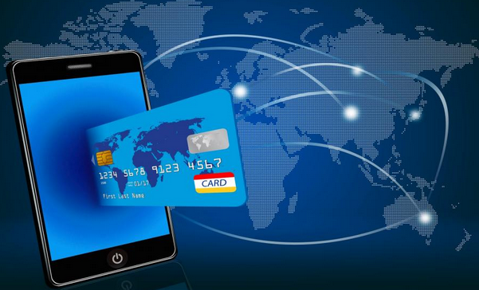
Proposal for UPI(Unified Payment Interface) Mobile Payment System
AKL Group

Slide 2


Introduction – UPI
Objective & Requirement
Solution Approach
Phase I features and implementation
Project Plan - High Level Timeline
Implementation Methodology – Key Activities
How to App Works
Questions
Powered By AKL

Slide 3
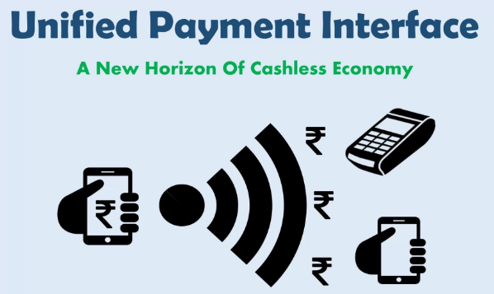
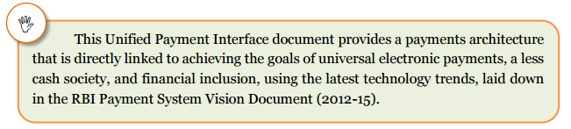
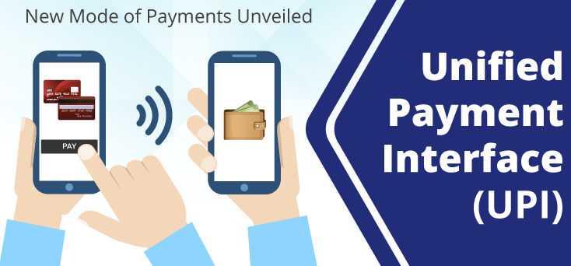
Introduction
Mission > To ensure payment and settlement systems in the country are safe, efficient, interoperable, authorized, accessible, inclusive and compliant with international standards.
Vision> To proactively encourage electronic payment systems for less-cash society.
National Payments Corporation of India (NPCI) after successfully launching the IMPS online payments system, has taken a step further in turning the Economy into a “less-cash” and more “digital society”. The launch of a Unified Payments Interface (UPI) adds a feather to its cap.
Powered By AKL Group

Slide 4



Objective & Requirement
The objectives of a Unified Payments Interface (UPI) is to offer an architecture and a set of standard APIs to facilitate the next generation online immediate payments leveraging trends such as increasing Smartphone adoption, Indian language interfaces, and universal access to Internet and data.
Simplify electronic payment through Mobile Handsets for instant electronic payments.
Real time sending and receiving money through Mobile Application for 24x7, 365 days, unlike RTGS or NEFT.
Transfer money to a beneficiary, without knowing their bank account number or IFSC code.
Newly introduced Virtual Payment Address (VPA) in the application which identifies customer account at beneficiary bank end.
Facility to add multiple bank accounts of different banks participating in UPI. No need to remember or share account details when using Virtual Payment Address.
It authenticates the identity of the user like a debit card does using the phone as a tool instead of a separate card.
Advanced version of Immediate Payment Service (IMPS) which was used to transfer money between bank accounts facilitating round-the-clock funds transfer service.
Powered By AKL Group

Slide 5


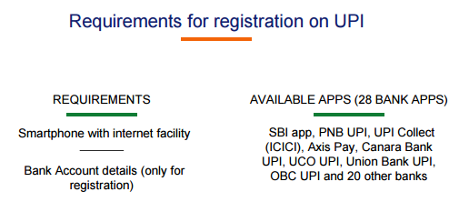
Solution Approach
Mobile Application will be available for Android devices and may be downloaded from Google Play Store.
Powered By AKL Group

Slide 6
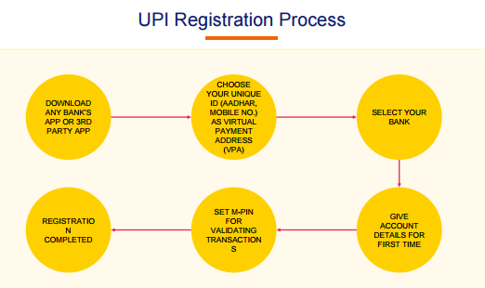
Solution Approach
Registration:
After downloading Application from store, system will install the UPI application in mobile handset (Google Play Store).
User has to open the Application after successful installation. After welcome screen system will display a message to put SIM with Mobile Number registered in bank in SLOT 1.
Application will send one message to verify the number (ensure sufficient balance in registered number) as shown in next screen:
On successful verification, mobile number on which UPI is being registered will be displayed. User has to confirm and accept terms and conditions of UPI as shown in next screens:
PoweredBy AKL Group

Slide 7

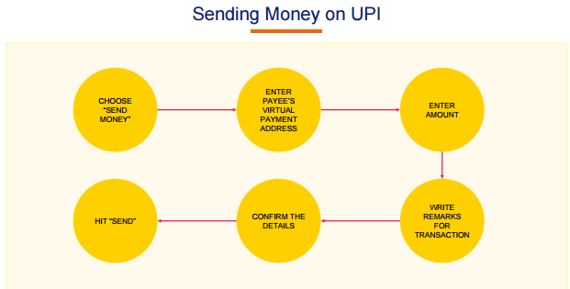
Phase I features and implementation
Powered By AKL Group

Slide 8

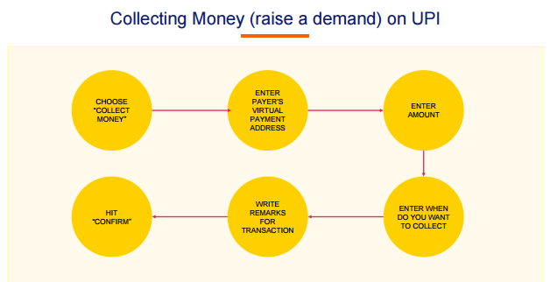
Features and Implementation
Powered By AKL Group

Slide 9
Implementation methodology – Key Activities
Plan & Define / Work Breakdown | Define Work Breakdown Structure & Point of Contacts.
Requirement | 1) Understanding the requirement & user interfaces, create Business Requirement Document (BRD) for New System. 2) Create System & UAT Test Cases for NewSystem. 3) Create Requirement Traceability Matrix (RTM) for New System. 4) Requirement Approval by Customer.
Design | 1) Create System Architecture Design Document & Approval. 2) Create System Integration Test Plan Cases
Build - CUT (Coding & Unit Test) | 1) End-To-End Development & Unit Testing. 2) Create & execute Unit Test Cases
Integration Test | Integration of all modules & present Demo.
UAT | User Acceptance Testing
GO-Live | 1) Install New System & Smoke Testing of New System in Production Environment. 2) Release to start business. 3) Train Users.
Maintenance & Support | As and when required.

Slide 10
Project Governance - Team Structure & Roles
Subject Matter Experts
(CM OFFICE)
Users
Executive Director (Project Manager)
Development Team
Testing
Team
Powered By AKL Group
Notes:
Our starting position
Steering Committee –
Recognize Steering Committee members present
We are currently evaluating adding several non-voting members from outside of state government; SMEs/Advisors – Let us know if you have suggestions
Org chart will evolve
Purpose is to illustrate the cross-department involvement and commitment required
Different types of roles will be needed for success

Slide 11


How the APP work
Enter Amount
Down load the APP and Create UPI Address
Enter the Department UPI Address
Confirm the Details
Write remarks for
Transaction
HIT ‘SEND’
Powered By AKL Group

Slide 12
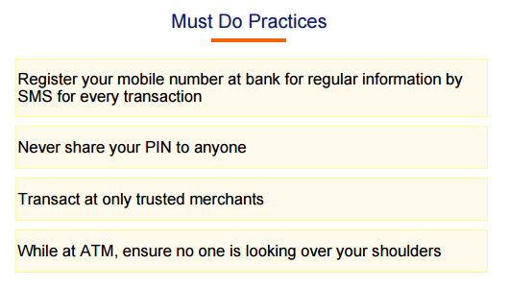
Recommendation & Best Practice
Powered By AKL Group

Slide 13
THANKS to BETTER SERVICE Your CUSTOMER

Slide 14
Make Friendship with AKL Group

Slide 15

Questions & Concerns
Notes:
Our starting position
Steering Committee –
Recognize Steering Committee members present
We are currently evaluating adding several non-voting members from outside of state government; SMEs/Advisors – Let us know if you have suggestions
Org chart will evolve
Purpose is to illustrate the cross-department involvement and commitment required
Different types of roles will be needed for success

